Slide 1
Concept of System Bus
Presented by Gaha Rohan
Class:11 Computer Science
Schools Name :VSSS

Slide 2
Concept of System Bus
Bus is a group of conducting wires which is used to describe the set of conductors that transmit data or that address or control information to the microprocessor’s different elements.
It is a high-speed internal connection.
They are used to send control signals and data between the processor and other components

Slide 3
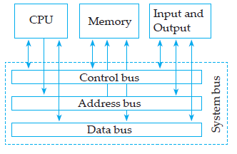
Bus Structure

Slide 4
Basic of System Bus
Bus, connects all the internal components of a computer, such as CPU and memory, to the motherboard. Internal data buses are also referred to as a local bus, because they are intended to connect to local devices.
The external bus, or expansion bus, is made up of the electronic pathways that connect the different external devices, such as printer etc., to the computer.
There are three types of buses.
They are mentioned below
Address bus
Data Bus
Control Bus

Slide 5
Address Bus
Address bus carries memory addresses from the processor to other components such as primary storage and input/output devices
The address bus is unidirectional because data flow in one direction, from microprocessor to memory or from microprocessor to Input output devices.
It is a group of conducting wires which carries address only.

Slide 6
Data Bus
It is a group of conducting wires which carries Data only.
Data bus is bidirectional because data flow in both directions, from microprocessor to memory or Input/Output devices and from memory or Input/Output devices to microprocessor.
Length of Data Bus of 8085 microprocessor is 8 Bit (That is, two Hexadecimal Digits), ranging from 00 H to FF H. (H denotes Hexadecimal)

Slide 7
Control Bus
Control bus is a group of conducting wires, which carries control signals from the processor to other components.
The control bus also carries the clock’s pulses. The control bus is unidirectional.
It is used to generate timing and control signals to control all the associated peripherals, microprocessor uses control bus to process data that is what to do with selected memory location.

Slide 8
Example of Control Signals
Some control signals are:
Memory read
Memory write
I/O read
I/O Write

Slide 9
Thank you
ANY QUERIES

